Slide 1

ANOMALY DETECTION USING MACHINE LEARNING
- Nirmayi Kelkar (31141)

Slide 2
1. Introduction 2. Motivation 3. Literature survey 4. Isolation forest algorithm 5. Iris dataset 6. Result 7. Conclusion 8. References
AGENDA

Slide 3
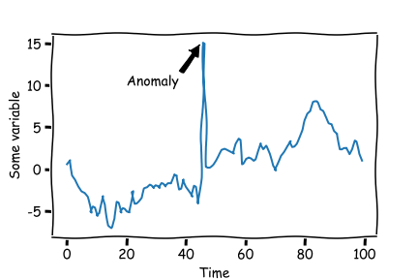
INTRODUCTION
Anomaly detection is the technique of recognizing an outlier or event that does not follow a particular trend.
Can indicate where error is occurring, enhance root cause analysis and quickly get technical support on the issue.

Slide 4

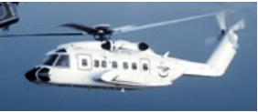


MOTIVATION
Vehicle safety
Critical medical data
Cyber attacks
Financial Fraud

Slide 5
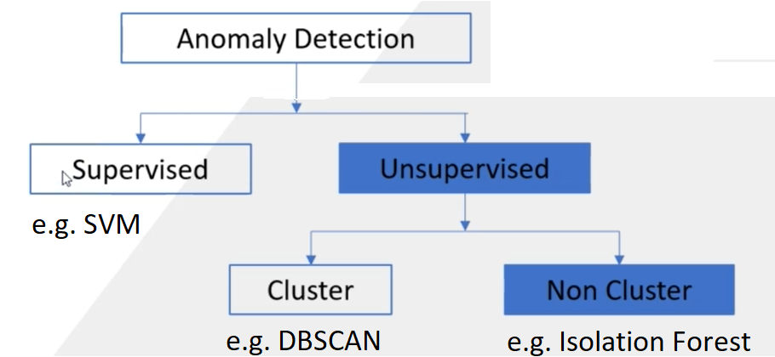
LITERATURE SURVEY

Slide 6
1.Label all instances that don’t fit normal profile as outliers Drawbacks:- 1.Approaches are seldom optimized to detect anomalies, so they underperform. 2.Many existing methods are constrained to low dimensional data and small size.
LITERATURE SURVEY

Slide 7
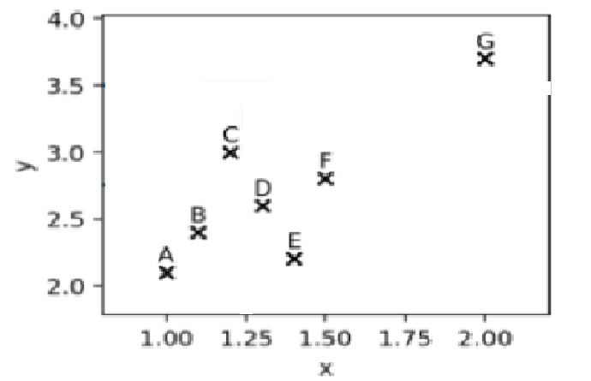
In each step: 1.Randomly choose x or y 2. Randomly choose a value to split the data on. 3. “Isolate” all data points to form I-tree.
ISOLATION FOREST (Liu et al., 2008) IDEA

Slide 8

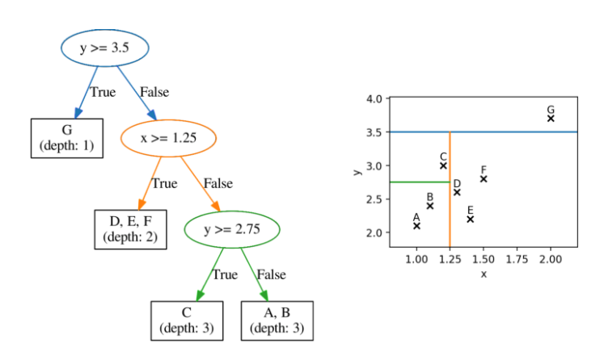
I-TREE
On average,
Outliers lie closer
to the root !

Slide 9
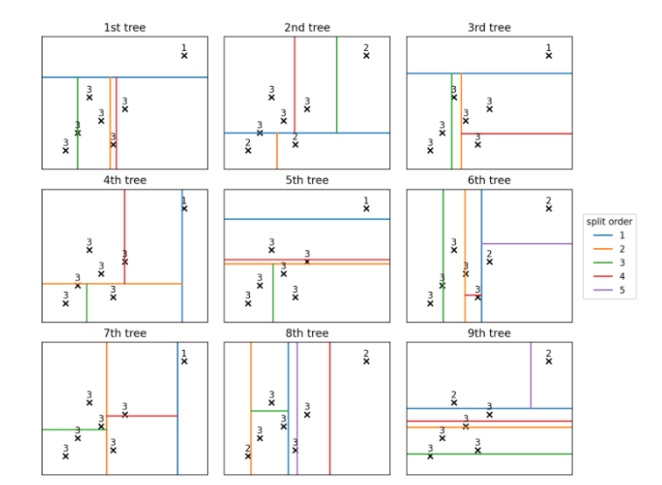
Many I-trees used for averaging (I-Forest)
I-FOREST

Slide 10
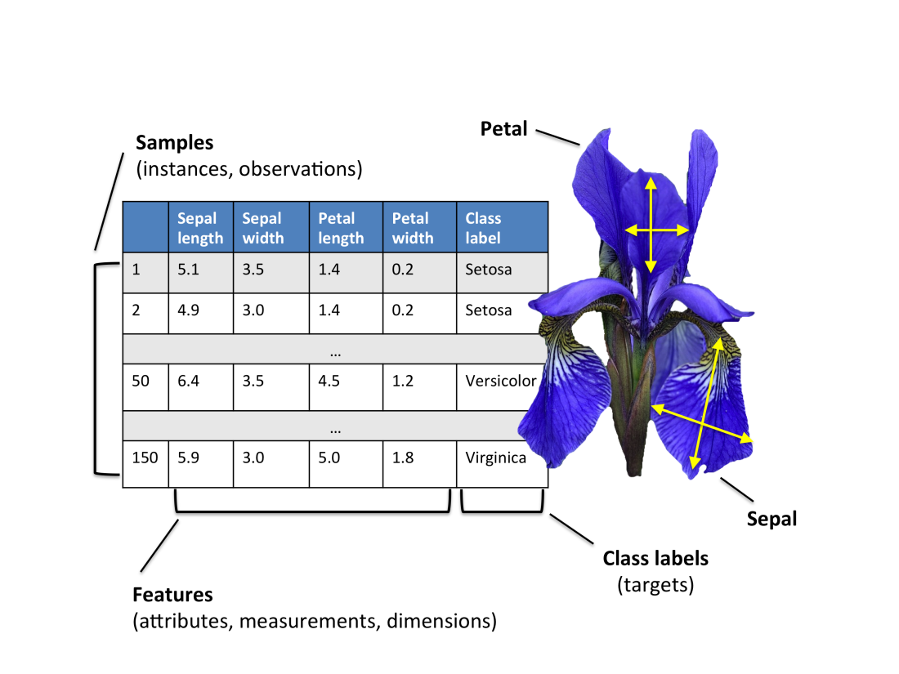
1. The data set consists of 50 samples from each of 3 species of iris flower
IRIS DATASET

Slide 11
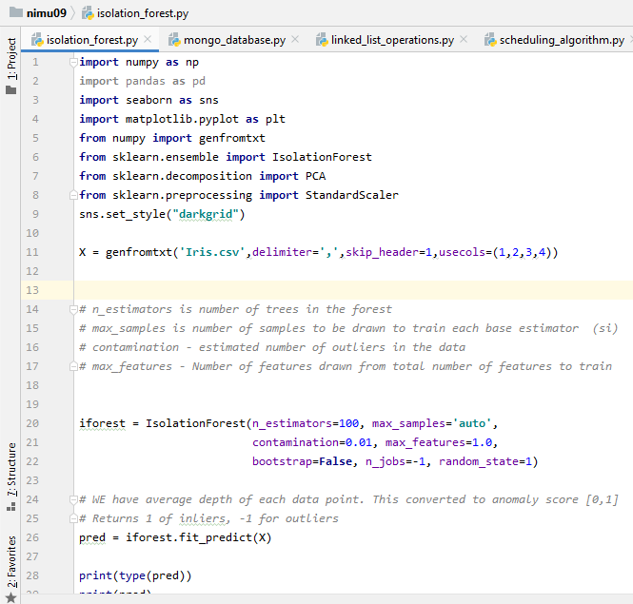
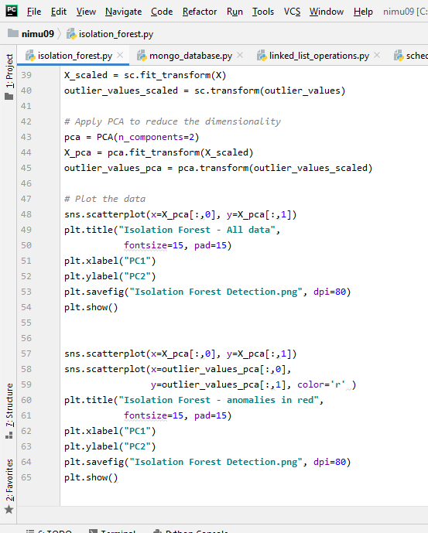
IMPLEMENTATION

Slide 12
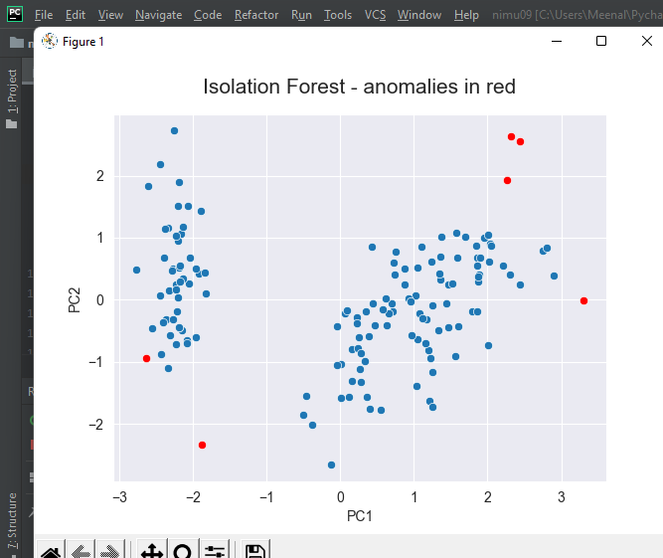
OUTPUT
Outliers detected
and validated
against literature
Number sensitive to contamination factor

Slide 13
CONCLUSION
Performed literature survey of techniques for anomaly detection.
Analysed the unsupervised machine learning algorithm “isolation forest”.
Successfully implemented it on IRIS data set.

Slide 14
1. Ali Bou Nassif, Manar Abu Talib “Machine Learning for Anomaly Detection: A Systematic Review,”.Publisher-IEEE.doi:10.1109/ACCESS.2021.3083060.Date of publication:25 May 2021. 2. Chandola V Banerjee, A. Kumar, V (2009), “Anomaly Detection:A Survey”, ACM Computing Surveys, vol41, no. 3, September 2009, Article 15. 3. Liu, F.T.Ting, K.M and Zhou, Z.H.,”Isolation Forest”, in Proc. 8th IEEE Int.Conf.Data Mining, 2008, pp-413-422.
References

Slide 15


